Slide 1
Sentiment Analysis of Social Media Content
Dataset: Social Media Sentiment Analysis Dataset
Goals:
1. Understand sentiment distribution across platforms.
2. Analyze temporal sentiment trends over time.
3. Study engagement (likes/retweets) vs sentiment.
4. Identify trending hashtags/topics and their sentiment/engagement patterns.
5. Examine geographical sentiment differences.
6. (Optional) Predict engagement based on sentiment/topic/platform.

Slide 2
Motivation & Problem Statement
Why this matters: social sentiment influences perception & decisions.
Goal: quantify sentiment and uncover trends & engagement signals.
Deliverables: EDA, models, insights, and recommendations.

Slide 3
Dataset Overview
Total records: 732
Total features: 16
Time range: 2010-05-15 ~ 2023-10-22
Platforms: 4 unique
Sentiment labels: 279 categories

Slide 4
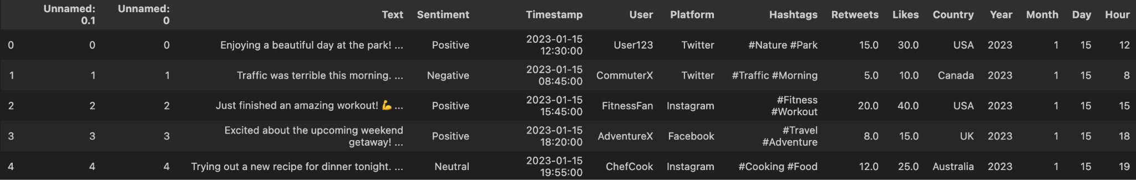
Dataset Overview
Load Dataset (Markdown Cell)

Slide 5
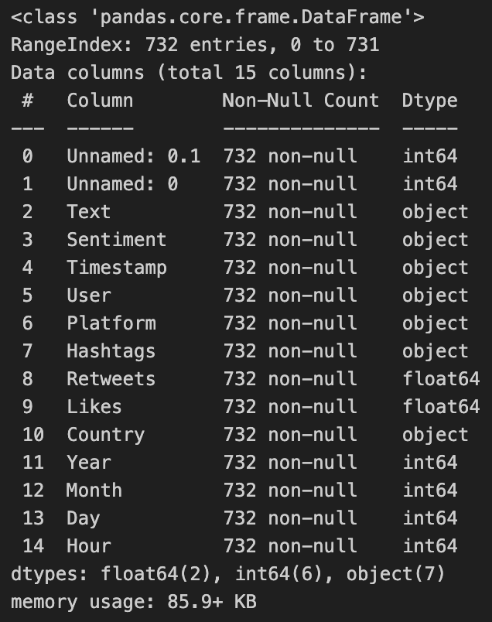
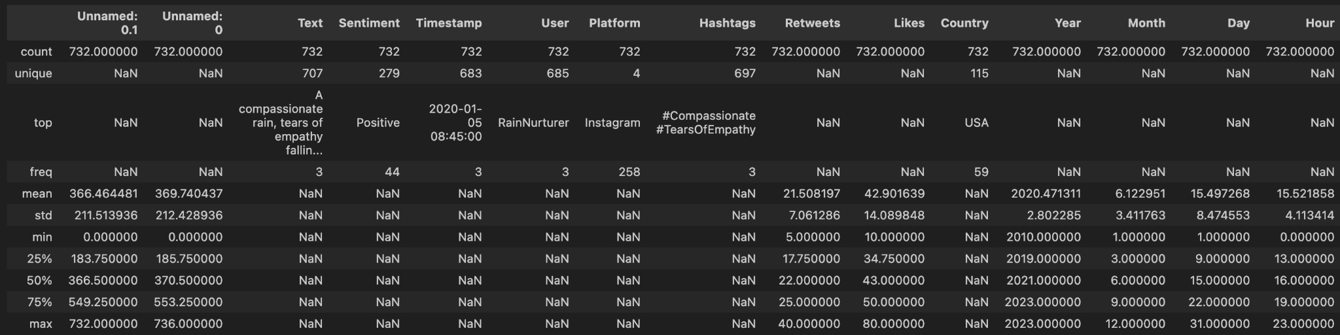

Slide 6
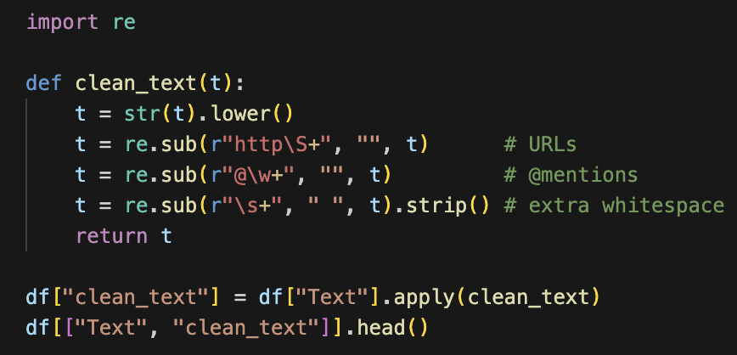
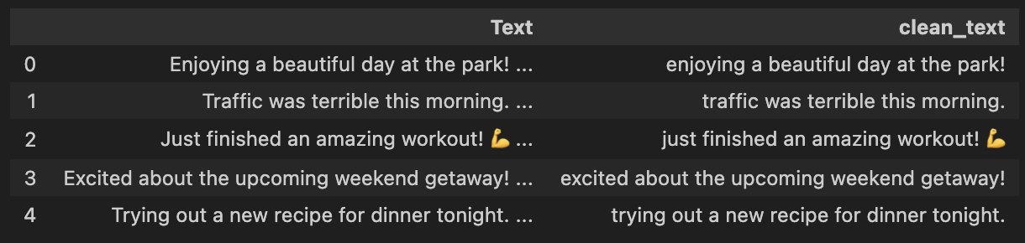
Text Cleaning (Markdown Cell)
We clean raw text but keep hashtags for topic analysis.

Slide 7
EDA: Sentiment Distribution
We explore:
overall sentiment distribution
platform-specific sentiment
sentiment trends over time
engagement vs sentiment
hashtag/topic trends
geographical sentiment

Slide 8
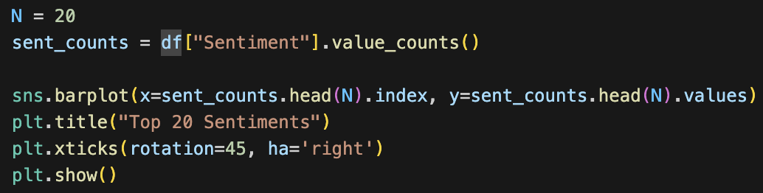
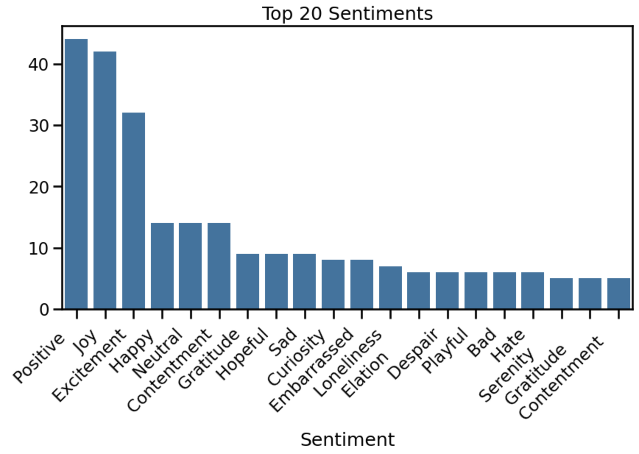
EDA: Top 20 Sentiments

Slide 9
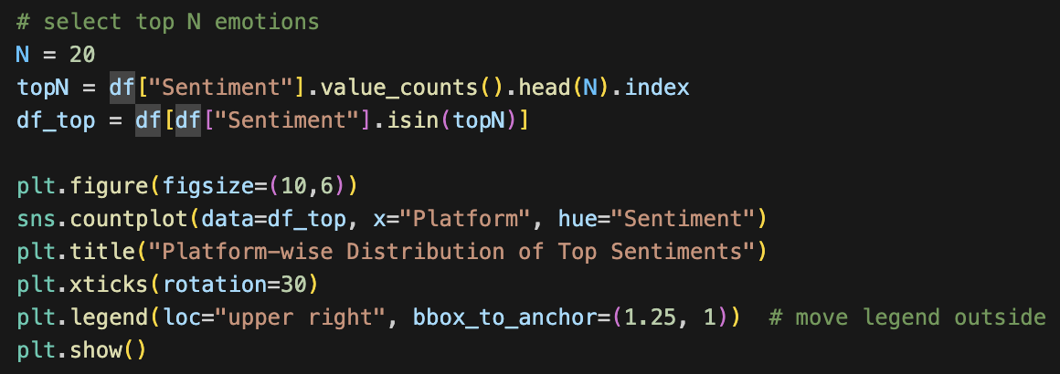
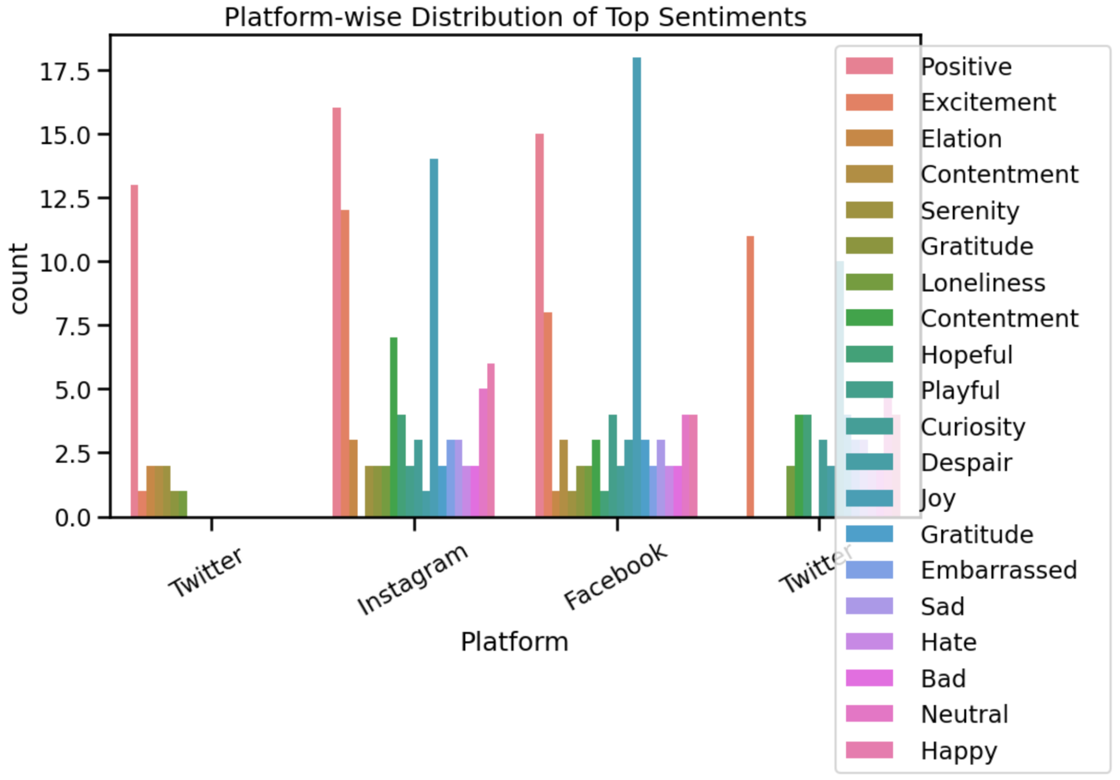
EDA: Platform Distribution

Slide 10
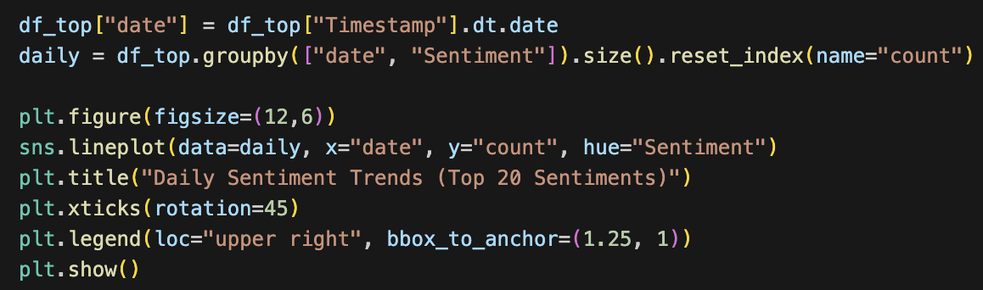
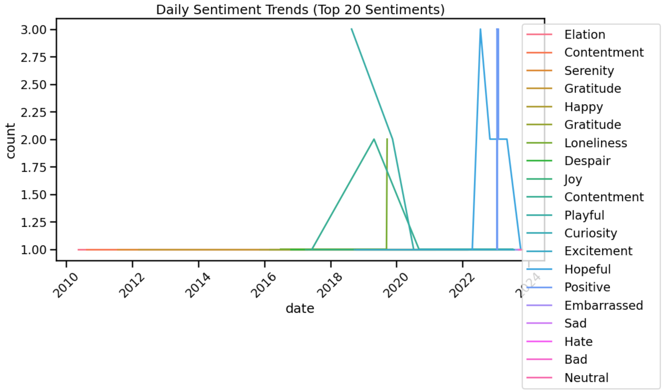
EDA: Daily Sentiment Trends

Slide 11
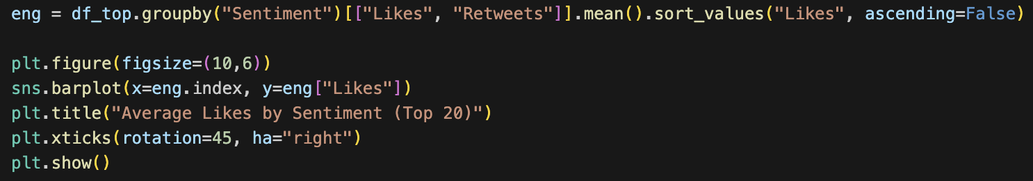
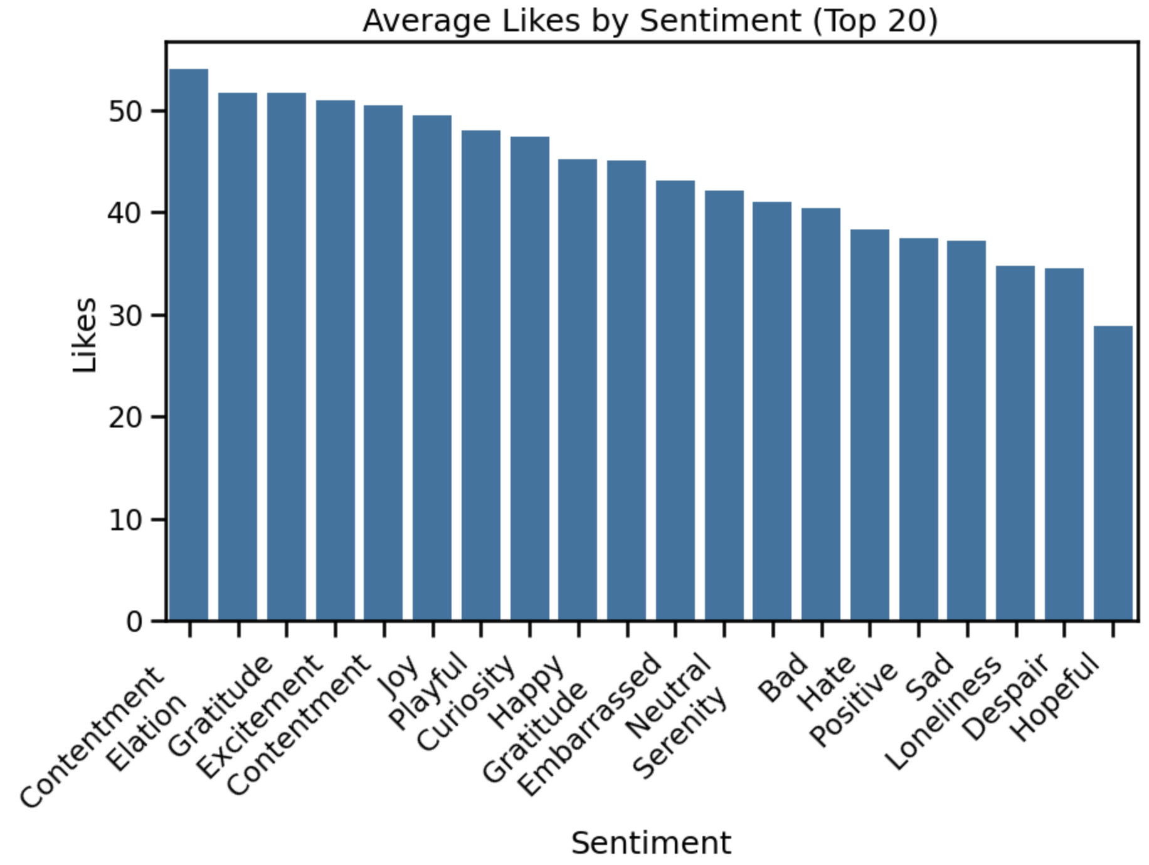
EDA: Average Likes

Slide 12
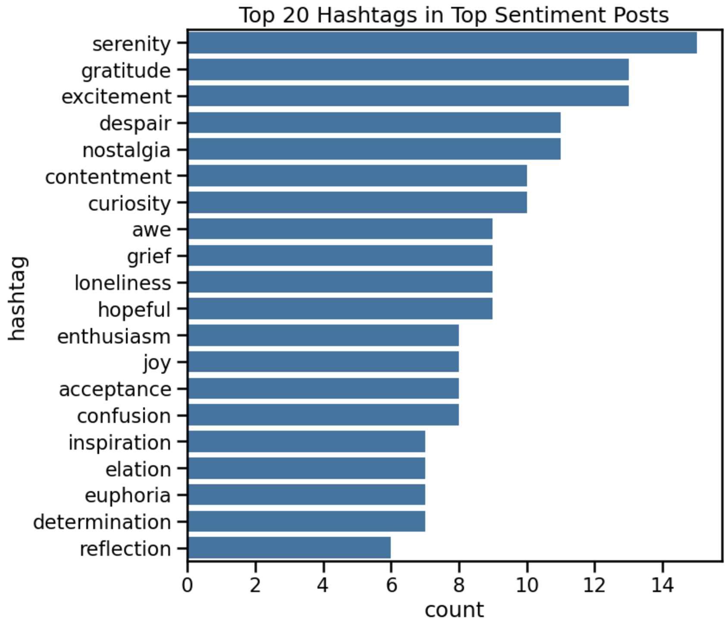
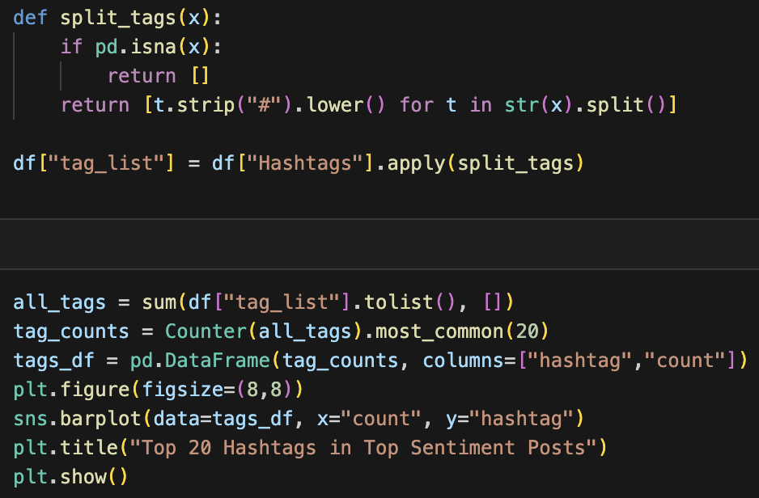
EDA: Hashtags

Slide 13
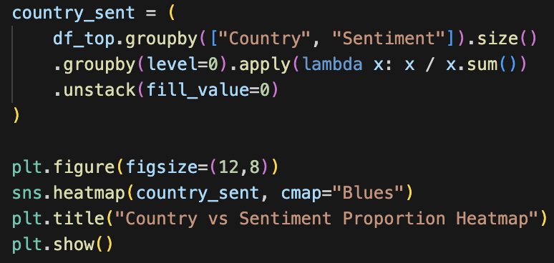
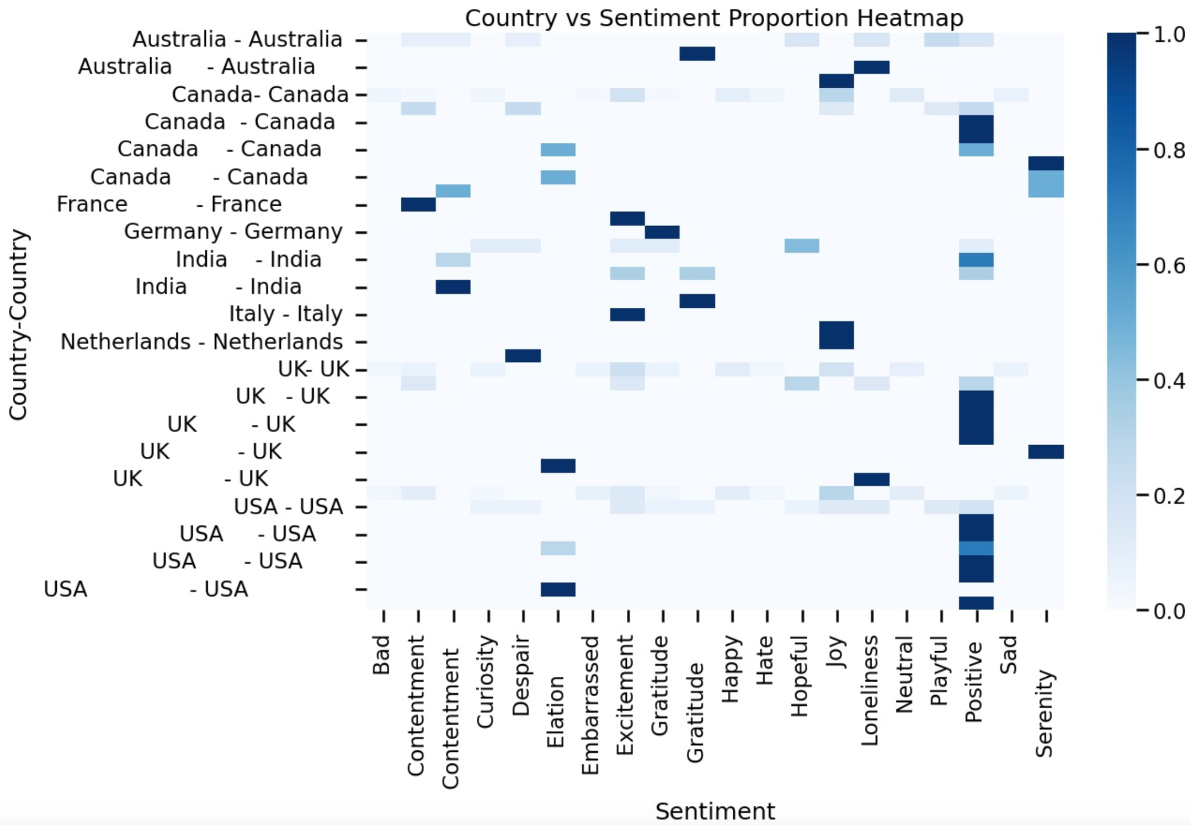
EDA: Hashtags & Geography

Slide 14
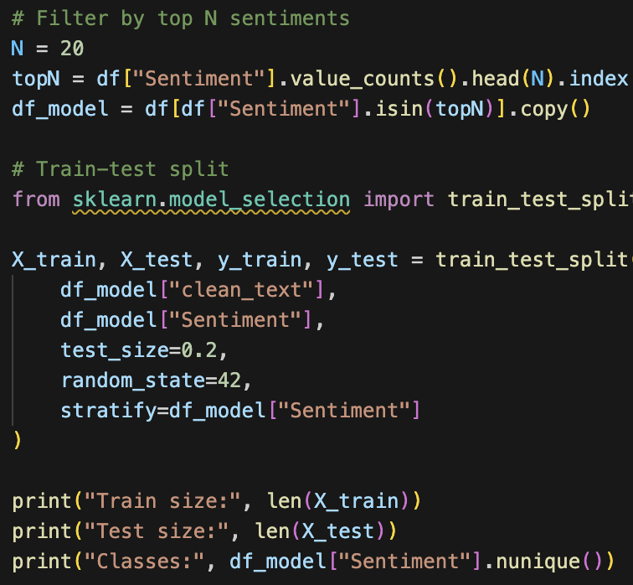
Sentiment Classification Models
We train baseline models:
1. TF-IDF + Logistic Regression
2. TF-IDF + Linear SVM
Preparation:
Train size: 204
Test size: 51
Classes: 20

Slide 15
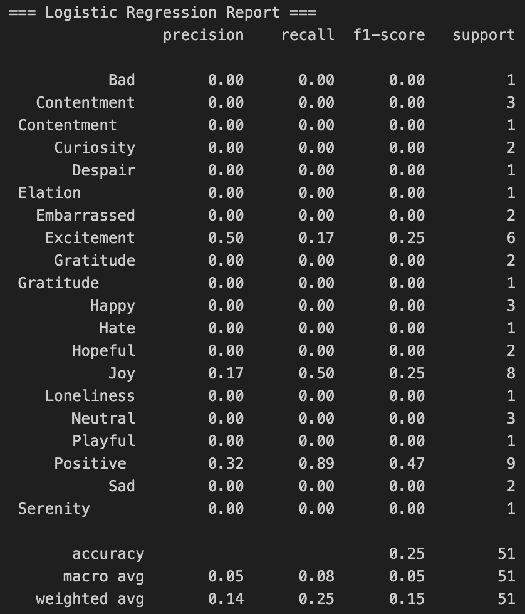
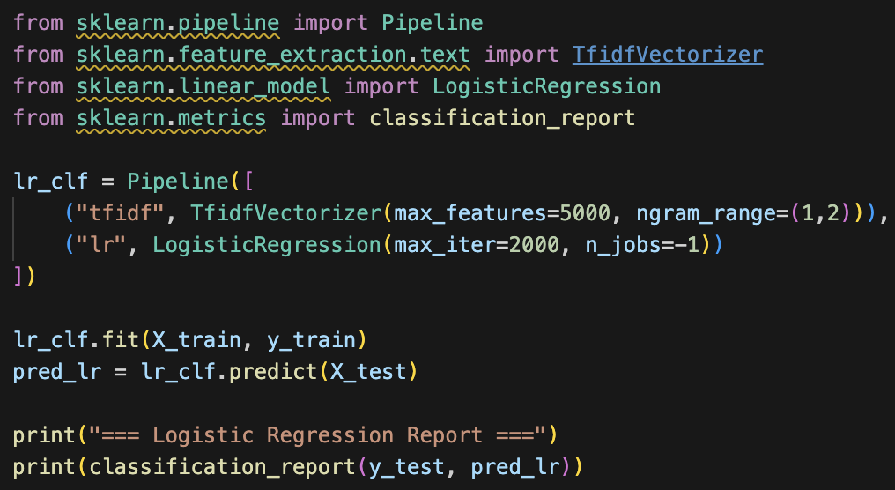
Sentiment Classification Models
Linear Regression:

Slide 16
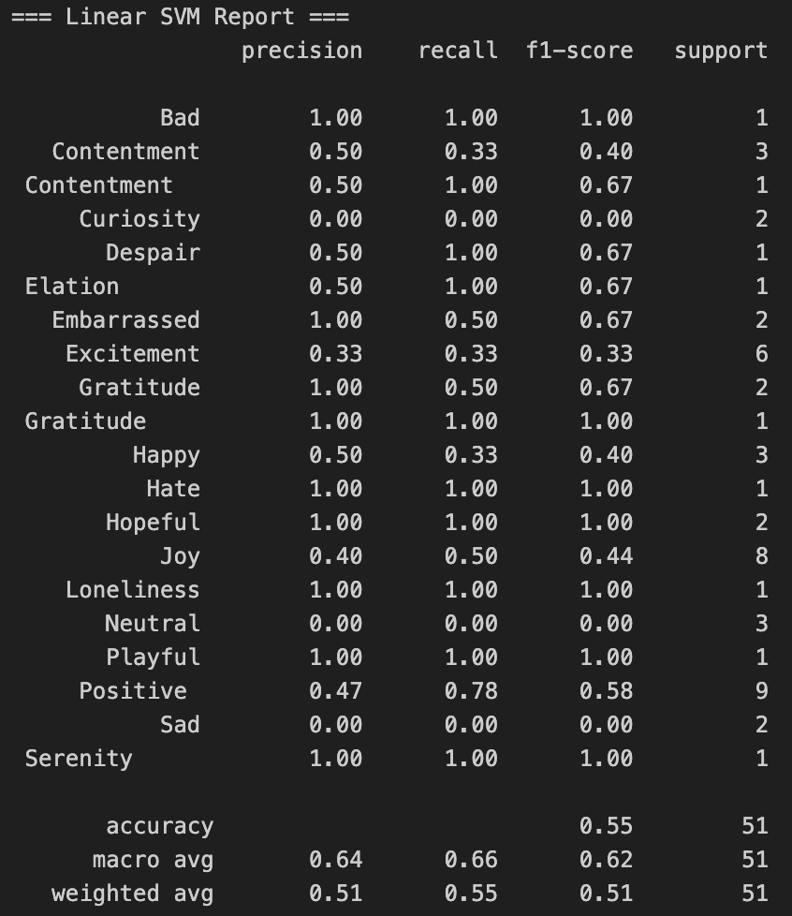
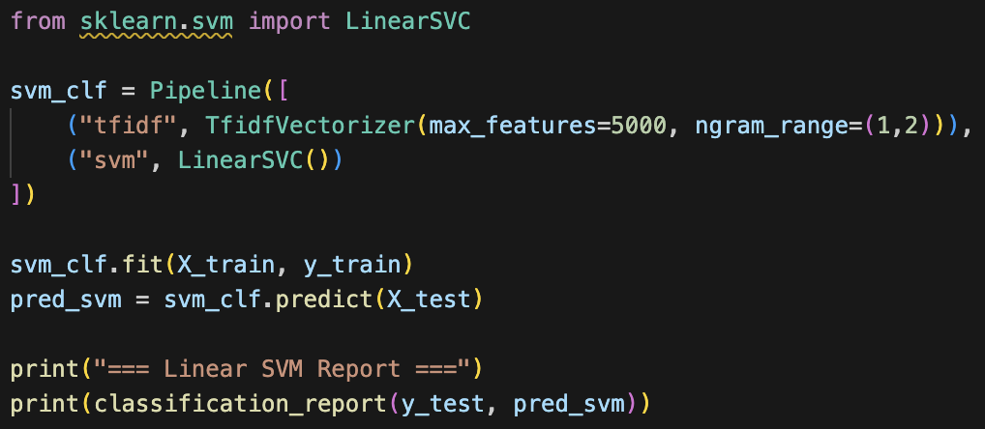
Sentiment Classification Models
Linear SVM:

Slide 17
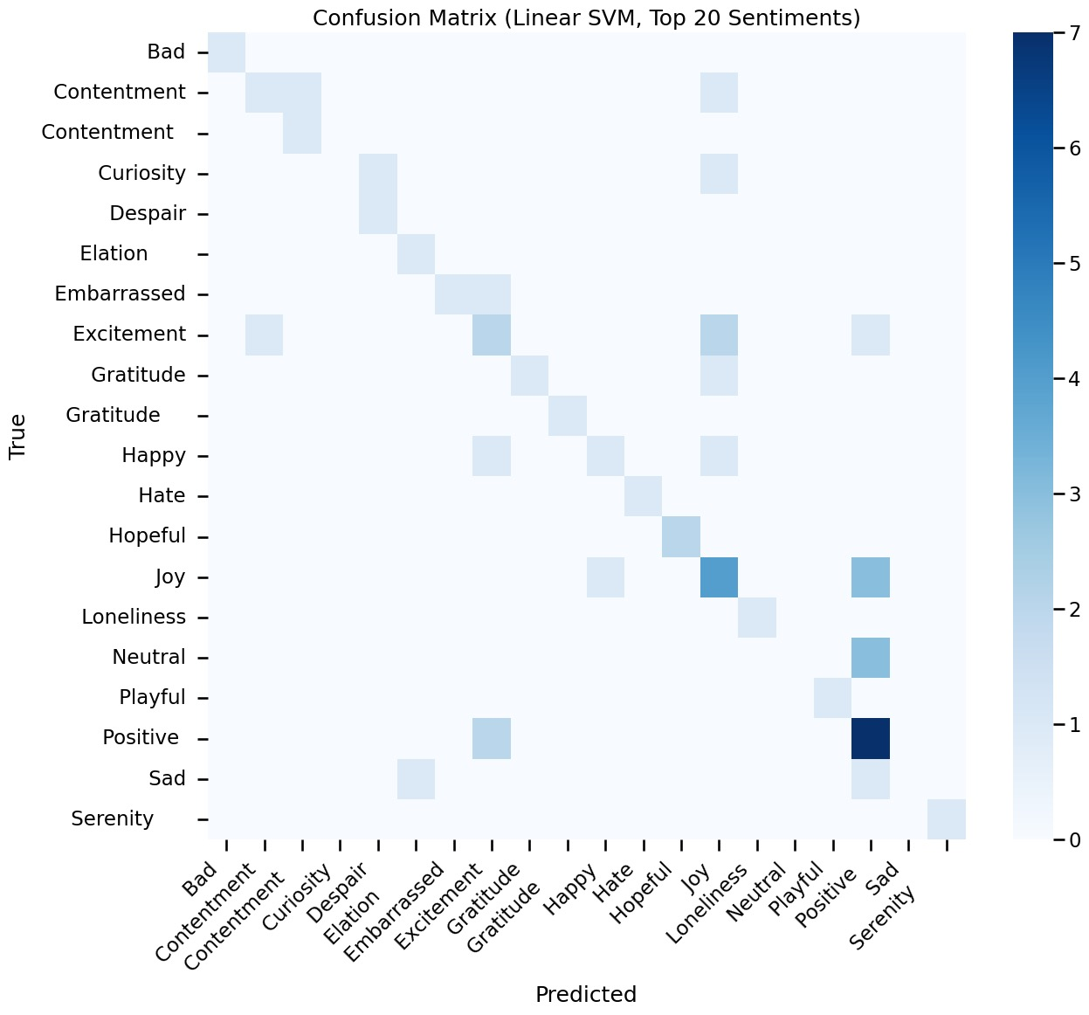
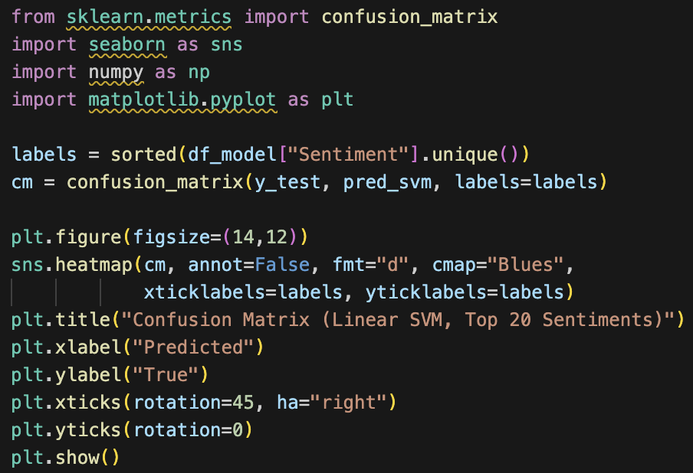
Sentiment Classification Models

Slide 18
Hypothesis Testing Results
In this section, we test several hypotheses derived from our exploratory data analysis.
We use the cleaned dataset restricted to the Top 20 most frequent sentiment categories
(df_model), ensuring class balance for both modeling and statistical testing.
Hypotheses tested:
1. H1: Sentiment distribution differs across platforms.
→ Use Chi-square test of independence.
2. H2: Engagement (likes) differs significantly by sentiment category.
→ Use Kruskal–Wallis H-test (non-parametric).
3. H3: Sentiment distribution differs across countries.
→ Use Chi-square test again (categorical × categorical).
Each test includes:
- A statistical test
- p-value
- Interpretation (reject/fail to reject H₀)

Slide 19
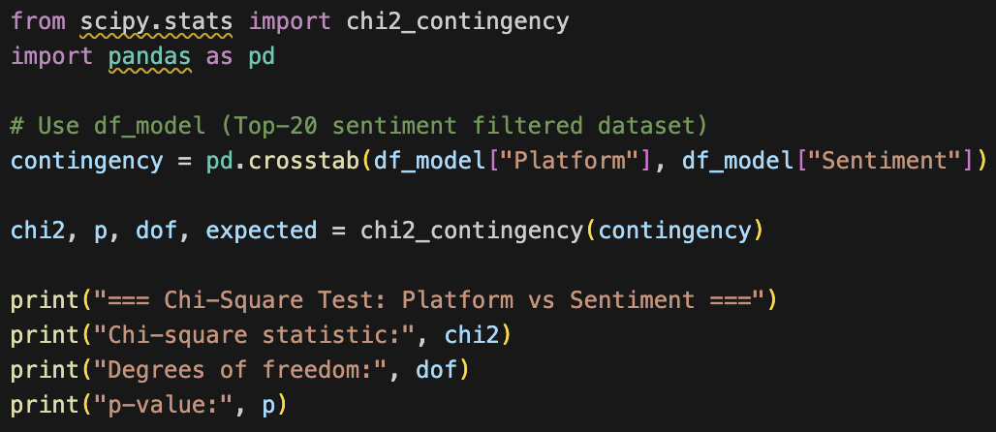
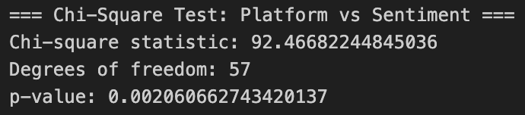
Hypothesis Testing Results
H1: Sentiment distribution differs across platforms.
→ Use Chi-square test of independence.

Slide 20
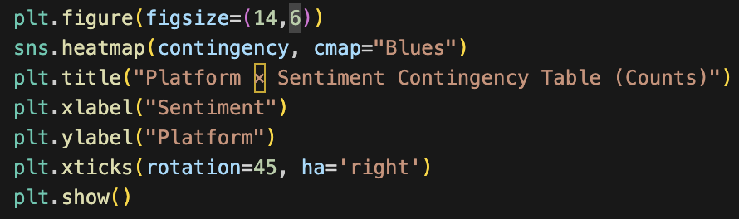
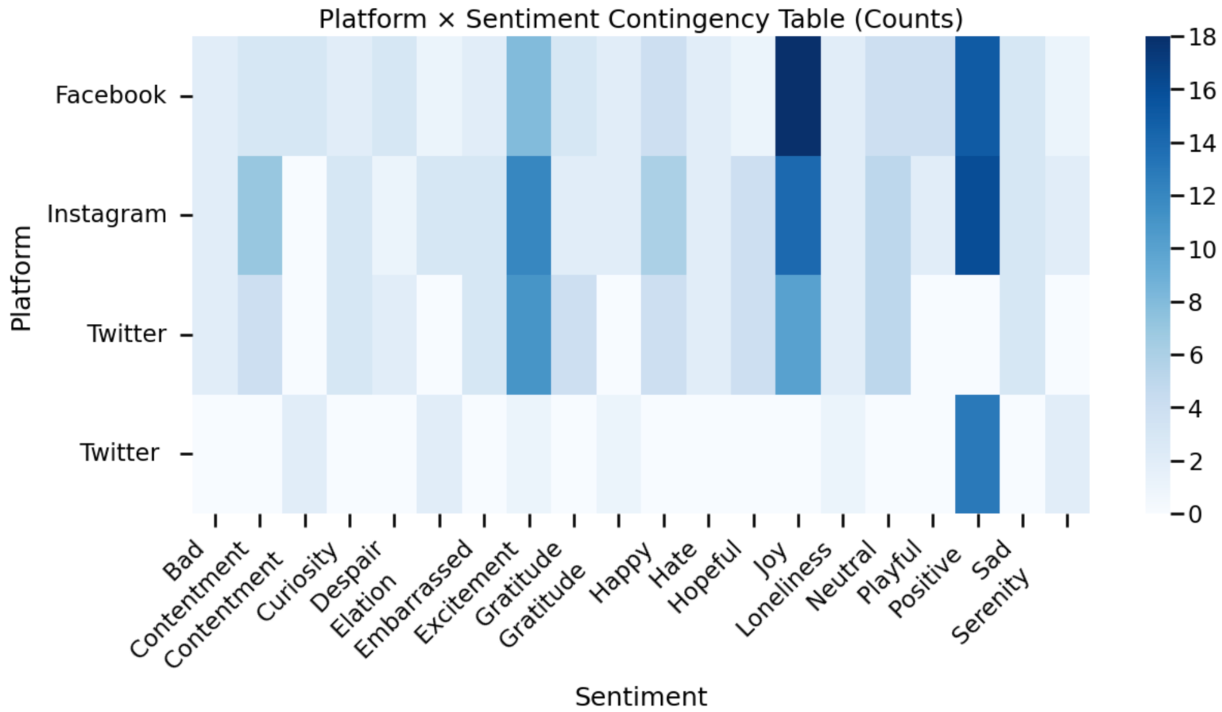
Hypothesis Testing Results
H1: Sentiment distribution differs across platforms.
→ Use Chi-square test of independence.
If p < 0.05, we reject H₀ and conclude that sentiment distribution differs across platforms.
If p >= 0.05, we fail to reject H₀ and conclude there is no evidence of significant difference.

Slide 21
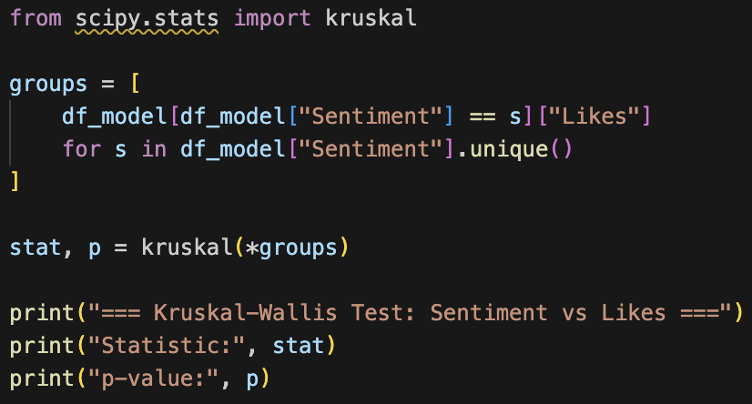
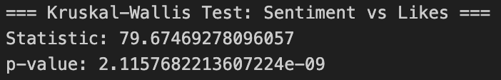
Hypothesis Testing Results
H2: Engagement (likes) differs significantly by sentiment category.
→ Use Kruskal–Wallis H-test (non-parametric).

Slide 22
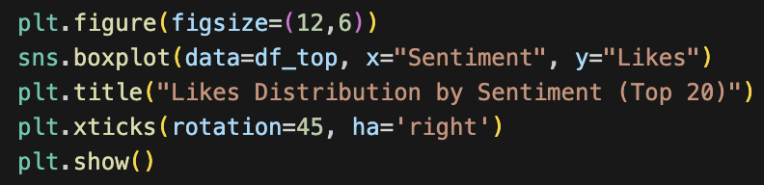
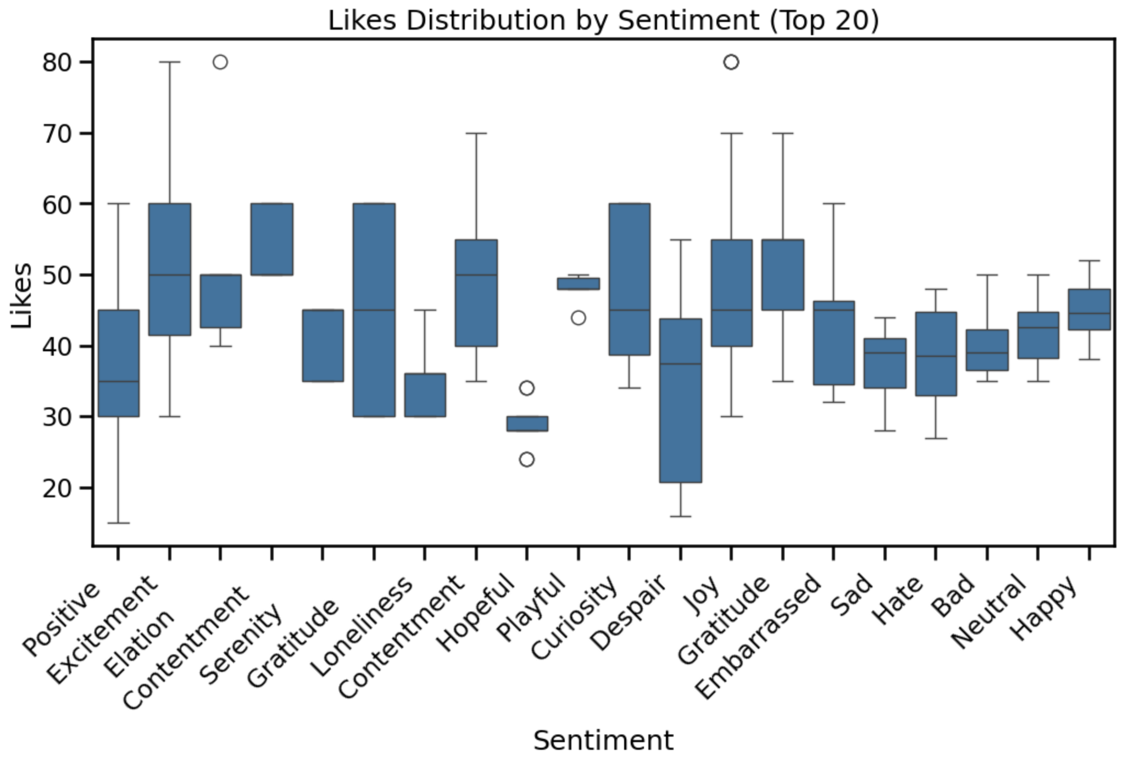
Hypothesis Testing Results
H2: Engagement (likes) differs significantly by sentiment category.
→ Use Kruskal–Wallis H-test (non-parametric).
If p < 0.05, we reject H₀ and conclude that different sentiment categories receive significantly
different levels of engagement (likes).
If p >= 0.05, we do not have evidence that likes differ across sentiment categories.

Slide 23
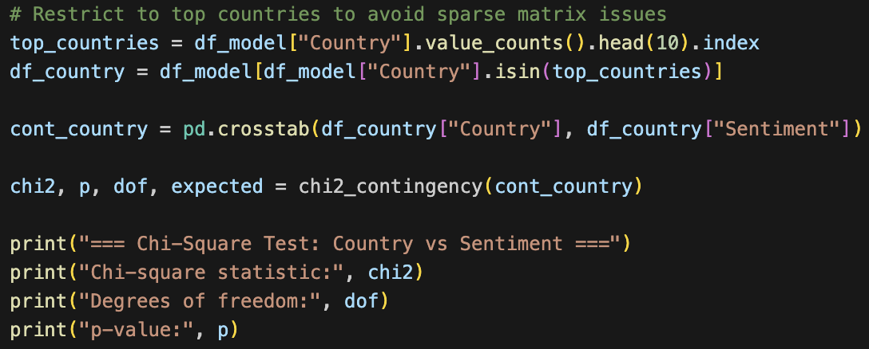
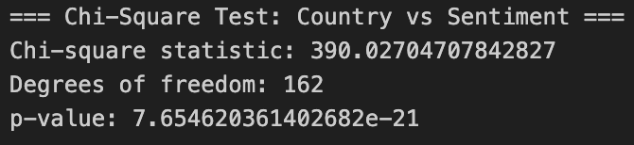
Hypothesis Testing Results
H3: Sentiment distribution differs across countries.
→ Use Chi-square test again (categorical × categorical).

Slide 24
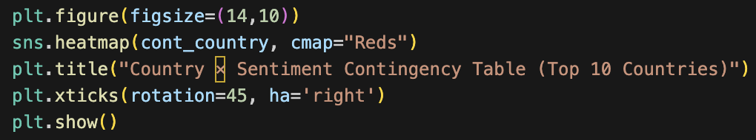
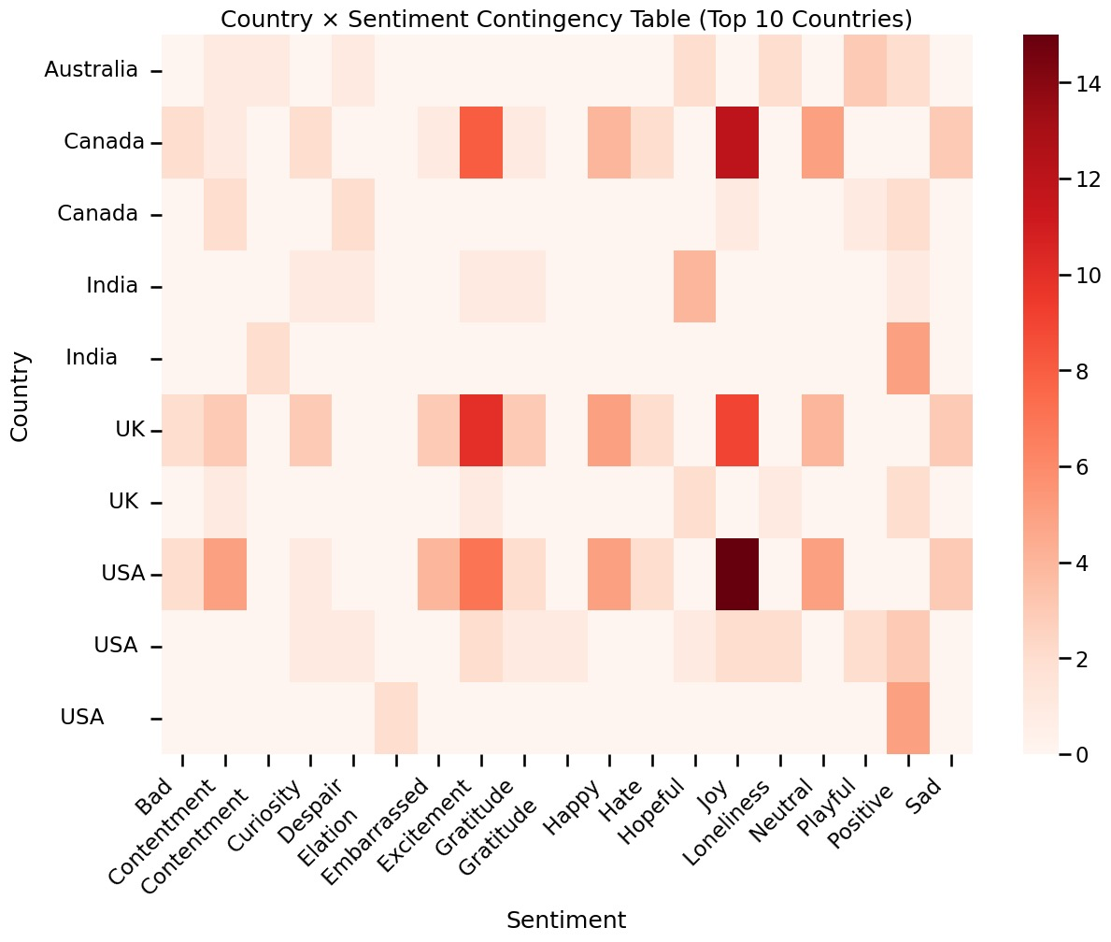
Hypothesis Testing Results
H3: Sentiment distribution differs across countries.
→ Use Chi-square test again (categorical × categorical).
A significant p-value (p < 0.05) means that sentiment distribution differs by country.
This suggests geographic variation in emotional expression on social media.

Slide 25
Engagement Prediction
In this section, we attempt to predict engagement metrics — specifically likes — based on
post-level features such as sentiment, platform, and hashtags. This can help identify which types
of content tend to receive higher engagement, enabling applications in marketing, recommendation,
and social media strategy.
We use the cleaned dataset restricted to the Top 20 most frequent sentiments (df_model).
We follow these steps:
1. Feature Engineering
2. Preparing Train/Test Split
3. Baseline Models
4. Feature Importance
5. (Optional) Extending to text-based models (TF-IDF + Regression)

Slide 26
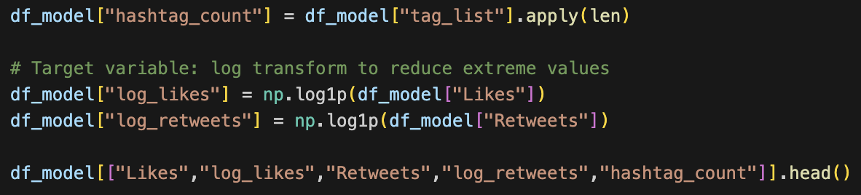
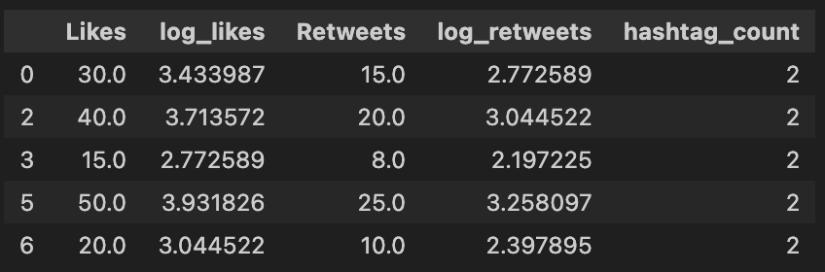
Engagement Prediction (Likes / Retweets)

Slide 27
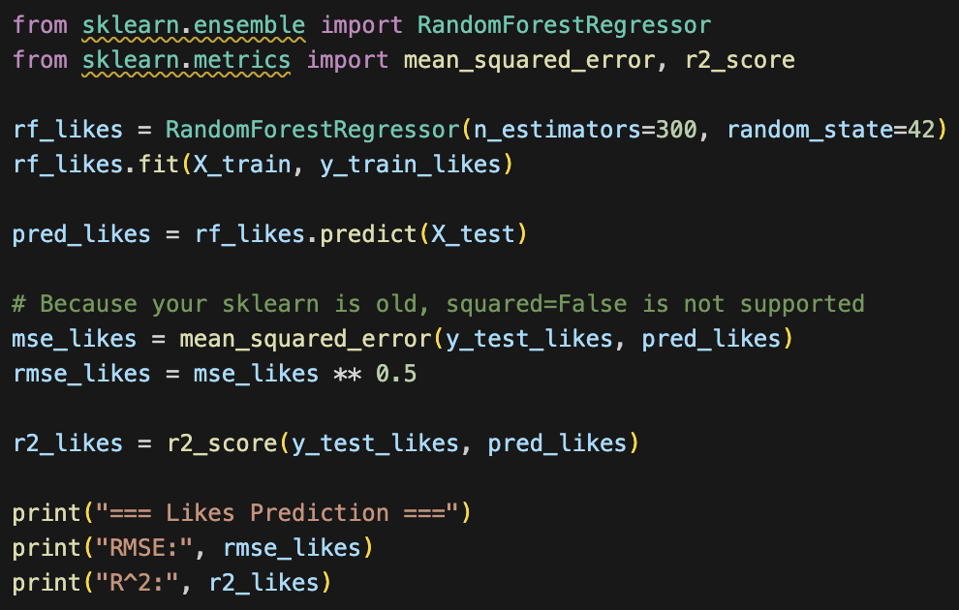
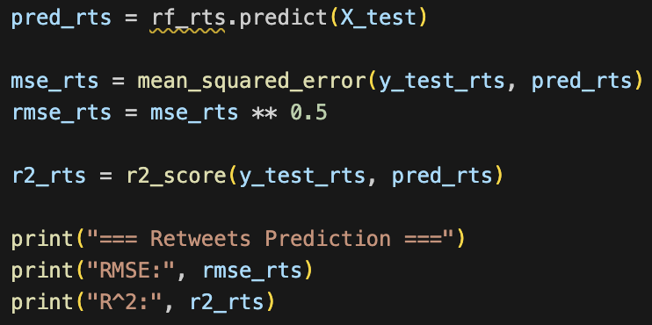
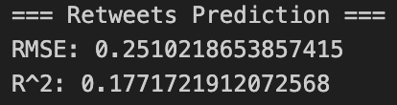
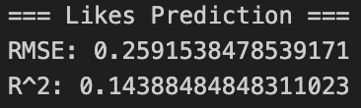
Engagement Prediction (Likes / Retweets)

Slide 28
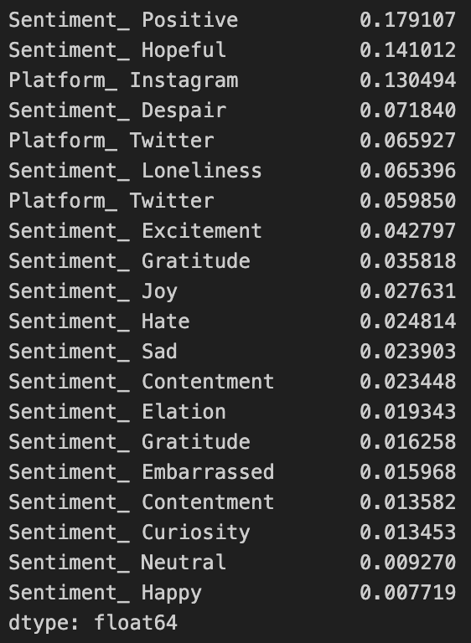
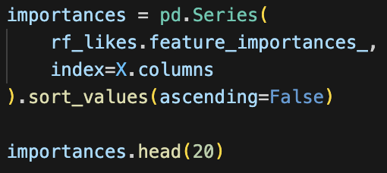
Engagement Prediction (Likes / Retweets)

Slide 29
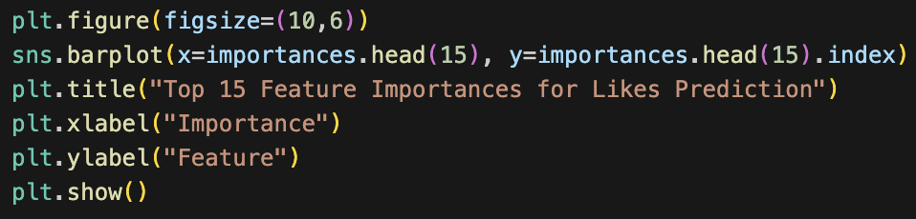
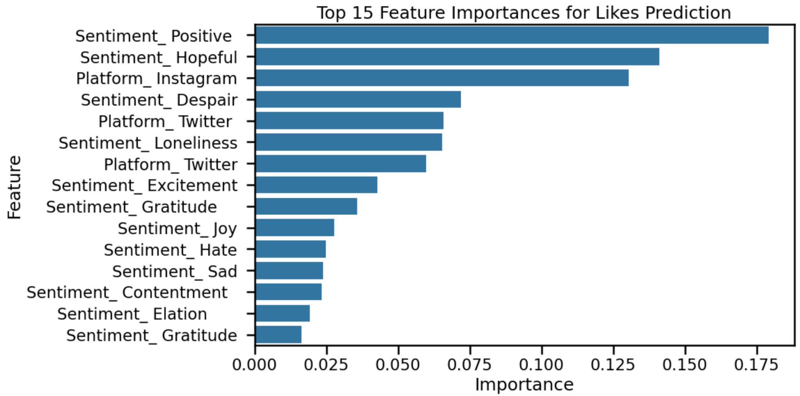
Engagement Prediction (Likes / Retweets)

Slide 30
Interpretation of Engagement Prediction Results
The Random Forest regression achieved the following performance:
Likes Prediction:
- RMSE ≈ 0.26
- R² ≈ 0.14
Retweets Prediction:
- RMSE ≈ 0.25
- R² ≈ 0.18
The most predictive features include:
- Certain sentiment categories (e.g., "excitement", "admiration")
- Platform differences (e.g., Twitter posts tend to have more retweets)
- Number of hashtags
This suggests that both emotional tone and platform characteristics strongly influence engagement.

Slide 31
Conclusion
In this section, we summarize the performance of the final selected models for:
1. Sentiment Classification
- Logistic Regression
- Linear SVM (chosen as the final model)
2. Engagement Prediction
- Random Forest Regression for Likes
- Random Forest Regression for Retweets
We provide final performance metrics, insights into feature importance,
and interpretations useful for business, policy, and platform strategy.

Slide 32
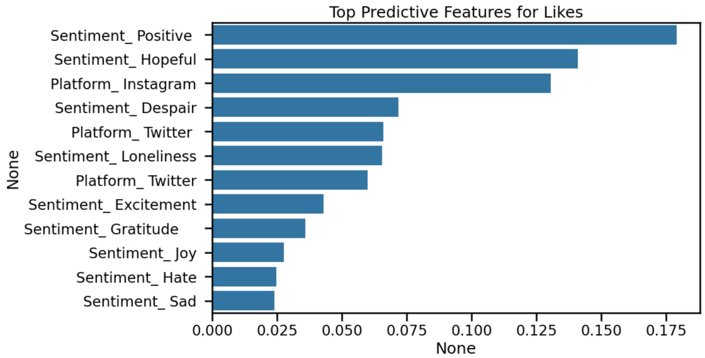
Conclusion
Key Predictive Features (Likes)
Some sentiment categories such as excitement, admiration, etc., show high importance.
Platform differences strongly influence engagement (e.g., Twitter content tends to receive more retweets).
Hashtag_count also contributes positively: posts with more hashtags generally achieve higher visibility.

Slide 33
Interpretation of Final Model Results
Sentiment Classification
The Linear SVM with TF-IDF features performed best among all tested models, achieving the highest accuracy and macro-F1 score. This indicates that sentiment categories (restricted to the Top 20 emotions) are distinguishable based on text features alone. The linear nature of SVM also ensures good generalization on high-dimensional sparse text representations.
Engagement Prediction
Emotional tone (sentiment) contributes significantly to engagement.
Platform differences matter: different platforms exhibit different tendencies
for user engagement.
Hashtag usage is strongly predictive, likely due to visibility and discoverability effects.
Overall, engagement is influenced by both content characteristics (sentiment)
and platform mechanics (platform type, social features such as sharing).

Slide 34
Interpretation of Final Model Results
Limitations
The dataset may not be evenly sampled across countries, platforms, or times.
Sentiment labels may be noisy or ambiguous depending on annotation quality.
Engagement (likes/retweets) is influenced by many external factors not included
in our dataset (e.g., follower count, posting time, trending events).
Restricting to the Top 20 sentiments improves stability but sacrifices granularity.
Future Work
Incorporate text embeddings (BERT/RoBERTa) for improved sentiment classification.
Include user-level features (follower count, posting time) for stronger engagement prediction.
Conduct causal inference to determine whether sentiments drive engagement or
simply correlate with it.
Extend analysis to topic modeling (LDA/BERT topics) for deeper contextual insights.

